Slide 1


Market Basket Analysis Using Apriori and FP-Growth
Presented by Vignesh S

Slide 2

Introduction
1
Market Basket Analysis
2
Business Understanding
Market Basket Analysis (MBA) is a data mining technique used to find associations between products.
Helps businesses understand customer purchasing behavior.
3
Practical Example
Example: If a customer buys Bread, they might also buy Butter.

Slide 3




Problem Statement
Analysis Need
Businesses need to analyze customer purchases to optimize sales strategies.
Strategic Value
Identifying product combinations helps in targeted marketing & promotions.
Technical Challenges
Challenges: Finding hidden patterns in large datasets efficiently.

Slide 4
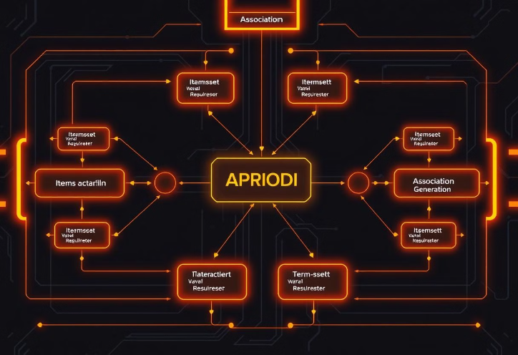
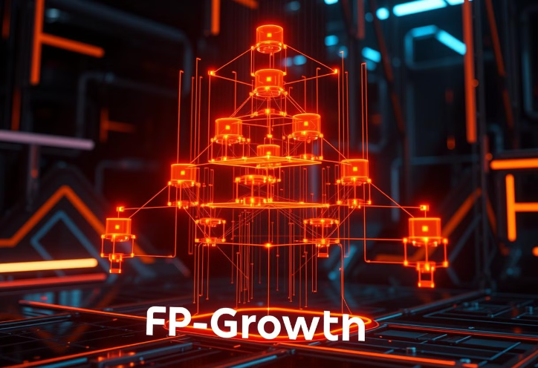
Algorithms Used: Apriori & FP-Growth
Apriori Algorithm
FP-Growth Algorithm
Apriori Algorithm: Finds frequent itemsets and generates association rules using support, confidence, and lift.
FP-Growth Algorithm: More efficient than Apriori, uses a tree-based approach for mining patterns without candidate generation.

Slide 5
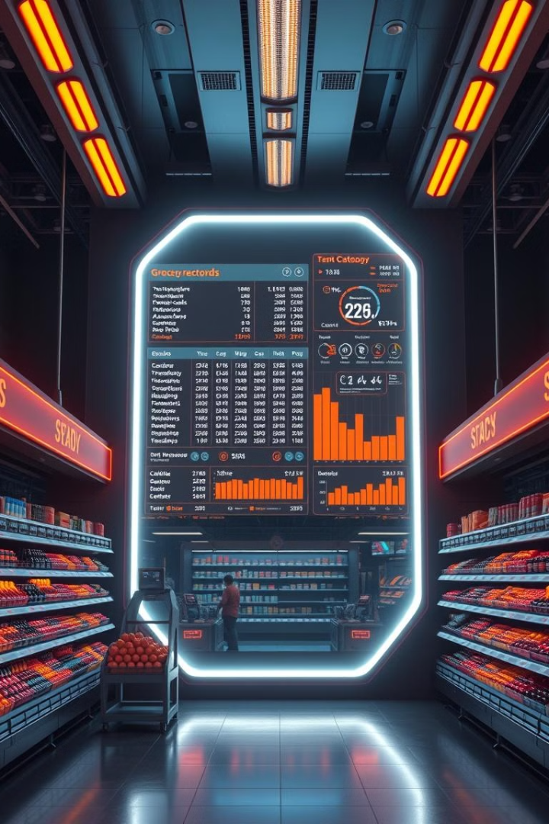
Dataset Description
Dataset
Fields
Dataset: Groceries Dataset containing customer transactions.
Member Number: Unique customer ID
Date: Purchase Date
Item Description: Product purchased
Source
Dataset Source: Kaggle - Groceries Dataset (https://www.kaggle.com/datasets/heeraldedhia/groceries-dataset)

Slide 6
Implementation Steps
Step 1
Load and preprocess the dataset.
Step 2
Convert transactions into One-Hot Encoding format.
Step 3
Apply Apriori Algorithm → Extract frequent itemsets & rules.
Step 4
Apply FP-Growth Algorithm → Find strong associations.
Step 5
Analyze and interpret the results.

Slide 7
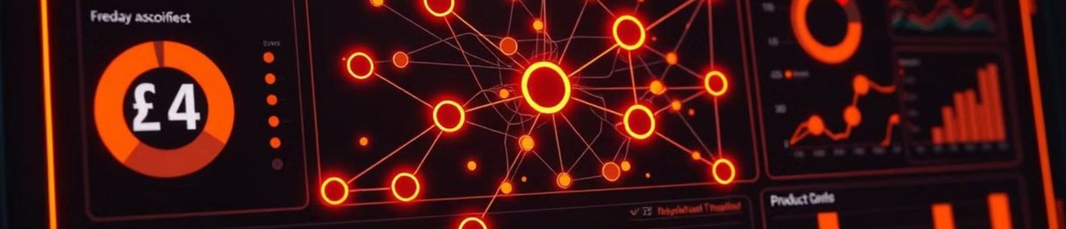



Results & Insights
Frequent Combinations
Association Rules
Customer Behavior
Discovered frequently bought item combinations.
Generated association rules for better product recommendations.
Helped understand customer purchase behavior for targeted marketing.

Slide 8



Conclusion & Future Scope
Future Scope
Future Scope: Apply AI/ML for real-time recommendations & personalized shopping experiences.
1
Algorithm Efficiency
2
Apriori & FP-Growth algorithms efficiently find hidden relationships in transactions.
Business Impact
3
Market Basket Analysis helps businesses increase sales through product recommendations & placement.

